Slide 1



Slide 2
From ‘dirty’ energy to sustainable energy:
UK Energy Policy and the role of community energy
Catherine.mitchell@exeter.ac.uk

Slide 3
Overview
How is energy developing at EU / global level?
  Much more practice change (ie increased renewables; new companies; more community energy) happening in countries other than GB
How is energy developing in GB?
  Energy, anyway always political, has become very political under the coalition
    Focus on nuclear power
    Lip service to renewables, efficient energy demand management, energy demand reduction, community energy etc
  Some changes at city / community level driven by people + changes occurring elsewhere

Slide 4
Context – Europe Overview

Slide 5
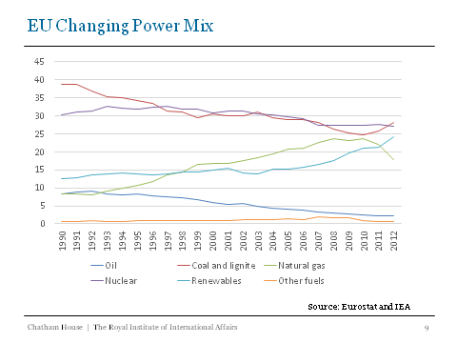
Notes:
Europe’s power mix is changing – renewables is the big winner

Slide 6
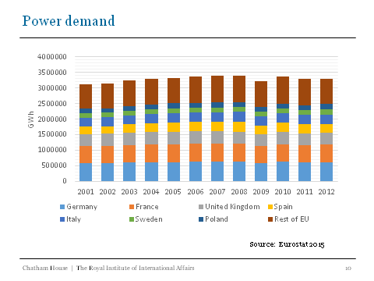
Notes:
Europe is not really using less energy

Slide 7
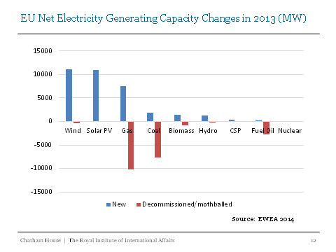
Notes:
But investment is really changing

Slide 8
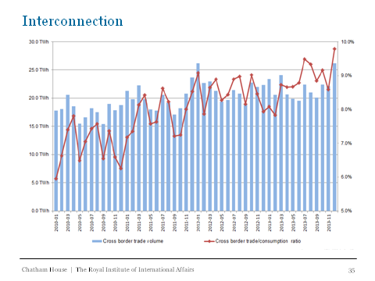
Notes:
Europe is becoming much more integrated
Interconnection helps an efficient use of energy
Also means less need for capacity investment

Slide 9
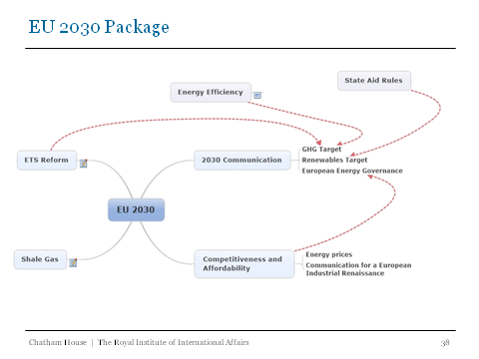
Notes:
What happens in the 2030 package – the next big EU energy policy will have major impact on funding / policies etc

Slide 10
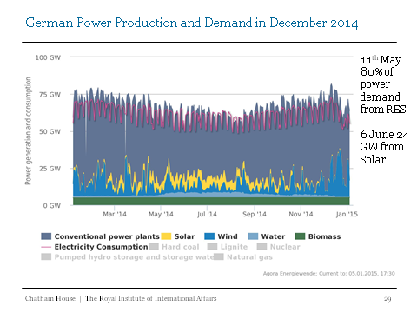
Some countries are undergoing fundamental change
Notes:
Some countries are undergoing fundamental change and that is causing all sorts of impacts outside of those countries eg UK
These changes are:
As variable power increases it pushes fossil fuels out of the electricity market because of zero marginal costs –
THEN
As variable power increases at peak times, it brings down the wholesale cost of electricity – where fossil fuel companies make their profits
SO
The combination of displacing fossil fuels AND bringing down prices is causing major problems for the big German utilities
AND
This is leading to the financial analysts to start to question whether the centralised utility model is past its sell by date
AND
Causing utilities to change
AND
Causing others

Slide 11
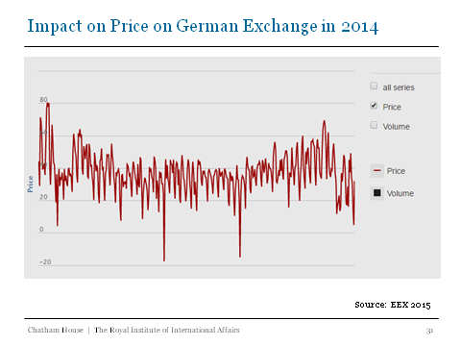
Notes:
Wholesale prices have dropped by about 40%

Slide 12
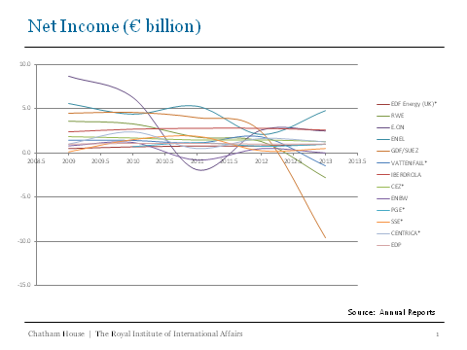
Notes:
The large European energy utilities are hurting – profits are down

Slide 13
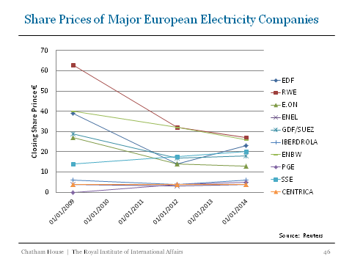
Notes:
Shares are down

Slide 14
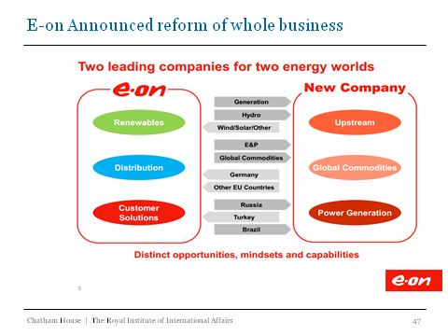
Notes:
E.on has seperated out its company in order to maximise investment

Slide 15
GB – a very different place
Self-reinforcing governance is in place in GB to keep the Big 6 incumbents dominant
  http://projects.exeter.ac.uk/igov/working-paper-change-and-inertia-in-the-uk-energy-system/
  Non-big 6 Suppliers still have only 9% of supply
EP focus been on nuclear
  Only a few likely to be built
Renewables, CE, demand side all secondary
BUT despite this there are some real changes occurring
Notes:
Self reinforcing
Privatised structure designed as no-risk, no-fail for newly privatised companies
Network incentives
Electricity market rules
Liquidity issues
Sticky customers
Within markets ie ability to buy and sell and transparency of electricity price
Vertical Integration
Codes and Licenses
Supplier Hub Model

Slide 16
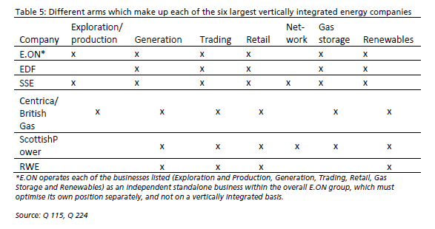
The GB electricity system is dominated by vertically integrated ‘Big 6’ incumbents in all parts of the value chain and in both gas and electricity
Source: Ofgem 2008
Notes:
Difficult to break in AS need customers to sell to

Slide 17
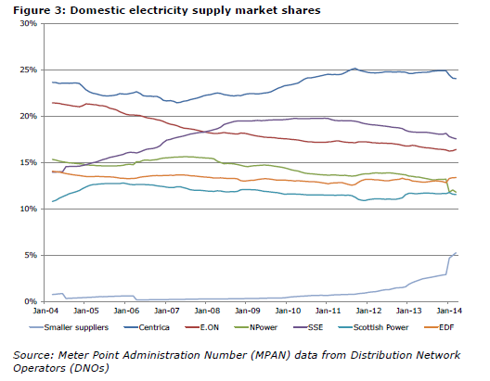
Non Big 6 supply whilst increasing at the end of 2013 (in part stimulated by ‘reset’ speech) is still only 9% of electricity, less for energy
(Ofgem OFT 2014 Market Assessment)
Notes:
It is getting better but switching still a problem

Slide 18
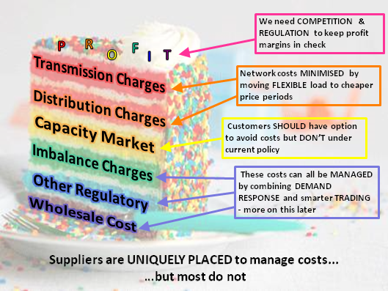
The system just not set up to make it easy for new entrants, new ideas
Notes:
This is a Tempus Energy Slide

Slide 19
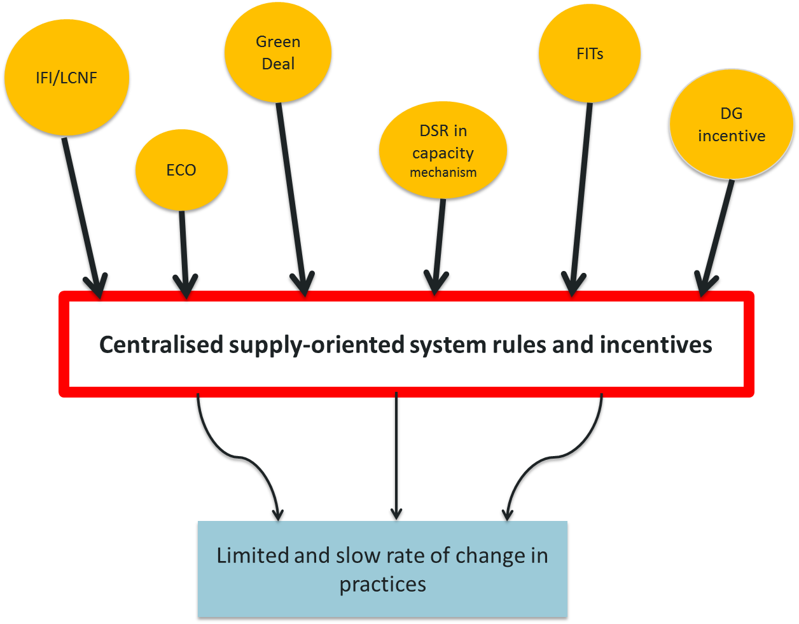
Demand side policies find it difficult to make headway in the current energy system
Notes:
Notes – include key themes on this slide:
It is widely recognised (i.e. official UK and EU policy) that we need to reduce demand, increase energy efficiency and have greater flexibility of demand
There are some energy objectives and policies in place that meet to these ends
However the underlying energy system is supply oriented (centralised, SOS and privatised)
The system is locked in and there is resistance to moving towards a demand oriented system – we are argue that much current governance tends to reinforce these elements of the current system and distorts, weakens or blocks demand policies
Demand side focus in policy
Carbon Plan: aim to cut per capita energy use by 20-50% by 2050
Electricity Demand Reduction (eg DECC programme, Energy Efficiency Strategy etc)
EU Energy efficiency target (non-binding 20% by 2020 against 2007 BAU projection); UK target (18% reduction against 2007 BAU projection)
Ofgem objective of facilitating demand side response
Green Deal
A working hypothesis
Design and effectiveness of particular policies depends on underlying energy policy paradigm, and rules and incentives created by governance of the wider energy system
The UK has a centralised, supply-oriented system (now privatised) with a high degree of inertia
The effects of policies are distorted, weakened or blocked by underlying rules and incentives
Some policy change but limited practice change
Drivers of change come mainly from outside the system (e.g. Climate Change)

Slide 20
Its not all doom and gloom in GB
Community Energy policy is inconsistent but
  numbers of CE groups increasing
  has various lobby groups now (eg CE England, 150 members)
  FITs has been a great success and kick-started all sorts of developments
City-wide projects also strengthening eg
  Public sector starting to want a new role
    Seeing energy as complementary to their goals
  New demand side new entrants eg Tempus
  OVO creating a new financial model
Electricity / heat coming together more
Individuals demanding more say in decisions

Slide 21
Achieving a sustainable economy
New ways to sell / reduce demand via new markets ie new groups of individuals, communities, cities in whatever way creating a new way of producing / using / selling
  It’s the way to change energy
  GB has not had the benefit of many policies available elsewhere but impacts of other countries is helping GB to change

