Slide 1

Annual General Meeting 2022
Wednesday 6 July at 18:00

Slide 2

Agenda
Taking of attendance
Information on voting procedures
Agreeing 2021 AGM Minutes
Extraordinary resolutions
Voting
Presentation of Annual Report
  4.1 Policy update
  4.2 Solar PV 1-3
  4.3 Healthy Homes for Wellbeing
  4.4 Retrofit
  4.5 Solar PV 4
  4.6 Social impact
  4.7 Community Fund
7. Presentation of accounts
Appointment of directors
8. Strategy discussion
9. Awards and recognition
10.AOB

Slide 3
Voting
Approve Directors’ recommendation to pay shareholder interest at 5%, year ending 31 March 2022
Approve the Accounts for year ending 31 March 2022
Agree for the Accounts not to be audited
Approve Directors’ recommendation to pay £3,500 from the profits of solar PV, plus such other amounts as are decided by the Directors into the Community Fund

Slide 4
Extraordinary resolutions – change in address
That Rule 2 (Registered Office) of the Primary Rules should be changed from Stephens Scown LLP, Curzon House, Southernhay, Exeter, EX1 1RS to Regen, Bradninch Court, Castle St, Exeter, EX4 3PL.

Slide 5
Extraordinary resolutions – change in wording
To develop and manage community owned renewable energy projects in Exeter.
To create a local green energy supply that improves Exeter’s energy security and resilience.
To raise awareness of and promote local low-carbon solutions to the global challenges of reliance on fossil fuels and their associated climate impact.
To facilitate community ownership and active participation that engages and strengthens the local community and its economy through volunteering, investment opportunities and becoming energy producers.
To create opportunities for further renewable energy and energy efficiency projects that contribute to addressing fuel poverty.
To create a community fund for local community projects.
To develop and manage community owned renewable energy projects in Exeter and the local area.
To create a local green energy supply that improves Exeter and the local area energy security and resilience.
To deliver and promote inclusive, practical, low carbon energy efficiency projects that enhance energy literacy, access and affordability and reduce fuel poverty.
To facilitate community ownership and active participation that engages and strengthens the local community and its economy through volunteering, investment opportunities and becoming energy producers.
To create a community fund for local community projects.

Slide 6
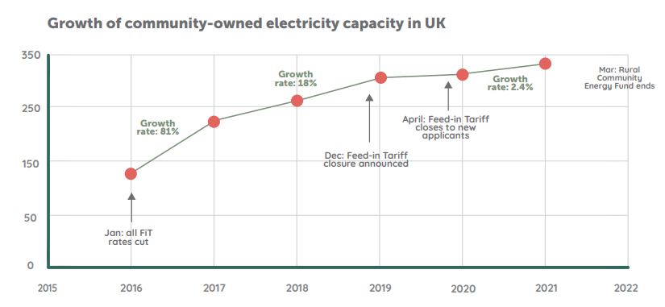
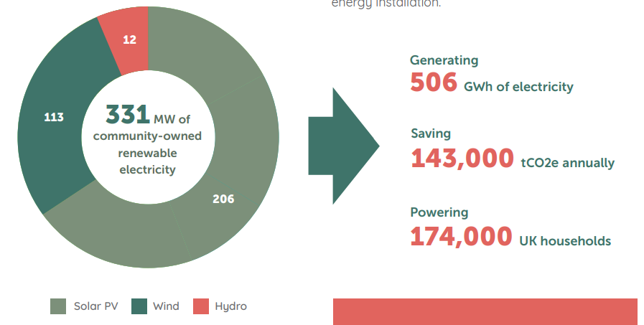
Policy update
End of any targeted governmental financial support for community energy
Access Significant Code Review (Access SCR) update
Past year from Government:
  Heat and Buildings, Hydrogen, Net Zero and Energy Security Strategies
State of the Sector 2022
Notes:
Government advice is to work with local authorities to use Shared Prosperity and Levelling Up funds.
DNOs will charge less for new/upgraded connections to the grid – so ECOE PV projects will potentially have decreased connection charges.

Slide 7




Solar PV 1-3
Generation
Y21/22 377 MWh
Y20/21 393 MWh
Revenue
Y21/22 £64k
Y20/21 £63k
4%
1%
Carbon Saving *
Y21/22 83.5 t
Y20/21 71.9 t
Building User Saving
£44k
Based on User Price 25p/kWh
14%
Issue - Glass House Lane Medical Centre non generating until July 2021
* Carbon Intensity calculated on quarterly basis from data at https://carbonintensity.org.uk/

Slide 8
Healthy Homes for Wellbeing
No of events/clinics
Y21/22 128 Y20/21 44
Revenue
Y21/22 £169.5k
Y20/21 £111.4k
191%
52%
No of enquiries
Y21/22 1005 Y20/21 206
388%
No of interactions (non LEAP)
Y21/22 2328 Y20/21 1040
Household Savings/Benefits
Y21/22 £1.72m
Y20/21 £755k
124%
128%
No of LEAPs
Y21/22 950 Y20/21 660
44%
*2017/18 170 predicted 2022/23 170 pm

Slide 9
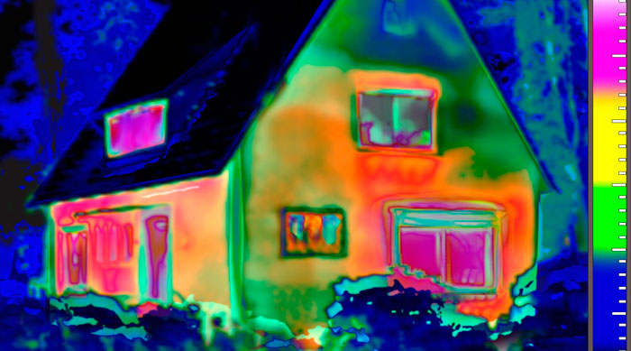
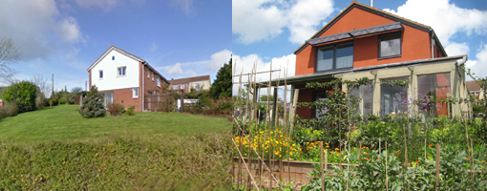
Retrofit in Devon
Impartial assessment
Identify improvements
Advise on pathways
Procure Installer(s)
Reduce carbon, Improve quality

Slide 10
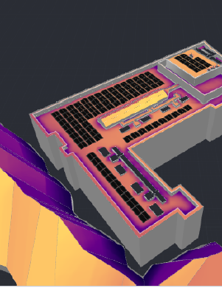
Solar PV 4
No feed-in-tariff subsidies, but high energy prices provide a better income stream, including grid export, for now
In discussions with six roof owners for new ‘solar PV4’ project
Four installations look feasible
    Total peak generation capacity 306kW, roughly 2/3 current total for ECOE’s 10 sites
Hope to get agreement in principle on some by September, then legal work likely to take six months
Will be recruiting for a project manager – anyone interested?

Slide 11

Social impact
“It has just given me more peace of mind re my electric bill. It means I have someone to contact with any problems.”
“The fact that Tara contacted BG on my behalf on a couple of occasions has been a huge benefit to me as I get very anxious. And she’s still helping with BG , which I’m really grateful for.”
“You guys have put my mind at rest and given me confidence and supported me where other organisations haven't. You've been caring and considerate.”
“Many people now choose to take the path to town rather than using their cars. Individuals comment on the tranquillity and beauty of the Dell and remark upon the bird song.
Notes:
Social impact analysis (SIA) examines how an organisation contributes to changes in society, including & beyond economic impacts
To study ECOE’s social impact we have:
Developed a client survey for the Healthy Homes program to better understand client needs, evaluate program & provide evidence of social impact
Piloted with 12 clients
Suggests increase energy literacy & client confidence; decrease in client stress & loneliness
Some clients note feeling supported was most helpful aspect of assistance
Examined the impact of ECOE Community Fund
Approximately £21,325 provided to over 15 applicant organisations since 2017
Provided direct or indirect support to over 1,300 community members
Enhanced work environments, youth education, reduction in vehicle use, cultivate biodiversity
Established an EDI director role & developing plans to assess EDI within ECOE

Slide 12
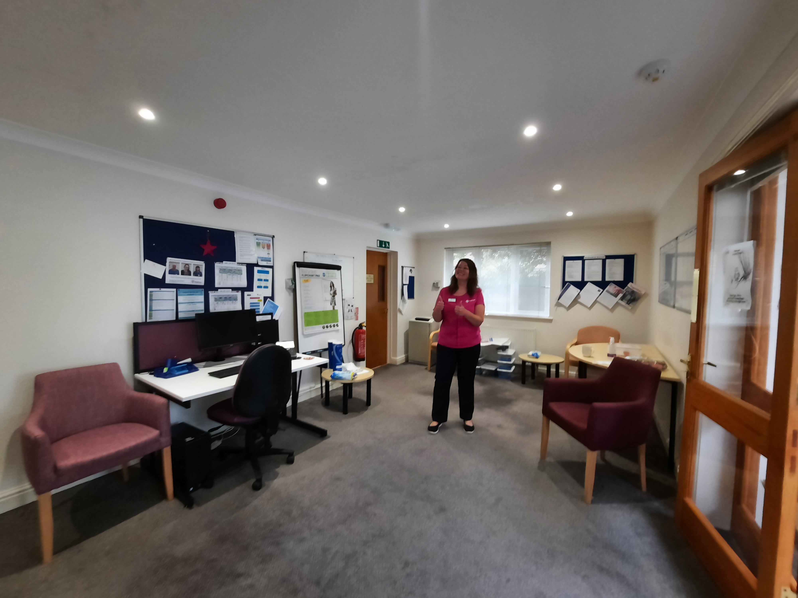
Community Fund
2020/2021 - £6,990 available
2021/2022 - £5,400 available​
  Six applications so far, OPEN to applications until 15 July 2022
Organisation | Purpose of grant | Grant
Hospiscare | Install LEDs | £460
Seadream | Providing energy savings advice to families in fuel poverty | £920
Transition Exeter | Help set up a Community Emergency Centre in Exeter city centre | £1,000
TRIP | Adaptation of a vehicle for wheelchair access | £1,000
Whipton Community Association | Replacement of fluorescent lights with LEDs | £500
Notes:
What is it? – a fund to spread benefit to the wider community
Aim: to provide grants for local projects that help to generate renewable energy, save energy and/or alleviate fuel poverty (tackling climate change and/or social justice)

Slide 13
Annual accounts
Sources of income | 2022 | 2021 | 2020
PV : Feed-in tariff | 41 | 35 | 41
PV: Export and PPA sales | 27 | 25 | 21
HH: ‘LEAP’ home visit funding | 66 | 67 | 91
HH: Grants and other funding | 35 | 44 | 26
HH: Provision of services | 68 | - | -
Donations and miscellaneous | 33 | 7 | 7
Total Income | 270 | 178 | 186
 | 2022 | 2021 | 2020
Shares issued | 353 | 378 | 398
Less deficit brought forward | -4 | -17 | -39
Surplus (deficit) for the year | 16 | 13 | 22
Redemption of share capital | -27 | -26 | -20
= Total Net Worth | 338 | 348 | 361
 | 2022 | 2021 | 2020
PV equipment | 348 | 375 | 363
Cash at Bank | 197 | 191 | 126
Debtors | 54 | 30 | 45
Total assets | 599 | 596 | 534
Less loans | 113 | 113 | 38
Less benefactor loan | 75 | 75 | 75
Less share interest owed to members | 19 | 20 | 20
Less other creditors | 54 | 40 | 40
Total Net Worth | 338 | 348 | 361
Project and category | 2022 | 2021 | 2020
PV : Delivery &operating expenses | 3 | 10 | 5
PV : Equipment depreciation | 28 | 23 | 21
HH : Delivery &operating expenses | 179 | 102 | 107
Hydro project grant |  | - | 0
ECOE’s overhead costs | 2 | 3 | 4
Members’ &loan interest (PV) | 20 | 22 | 21
Community fund | 4 | 4 | 5
Hardship fund | 18 | 1 | 2
Total costs | 254 | 165 | 165

Slide 14
Appointments
8.1 Standing for re-election: David Thompson
8.2 New directors: Francis Mosley and Prina Sumaria

Slide 15
Strategy
Mission
As a community-owned, not for profit organisation our mission is to deliver zero-carbon energy solutions for all.
Vision
Our vision is to enable the creation of a local energy system that is inclusive, decentralised, and decarbonised, where community is at the heart of the transition.

Slide 16
Awards, recognitions and thank you's
Sonya Bedford?
Patrick Devine-Wright
Stacia Ryder
Trevor Crawford
Thankyous
HEA of the Year
HH4WB Special Awards

Slide 17
AOB

