Slide 1

Annual General Meeting 2025
Wednesday 17th September at 18:30

Slide 2

Agenda
Welcome
  Taking of attendance
  Information on voting procedures
  Agree 2024 AGM Minutes
Presentation of Annual Report
  Solar PV 1-3
  Solar PV 4
  Policy Update
  Community Fund
  Charity Transition
  Finances
Voting
  Shareholder interest rate
  Approve the accounts
  Agree accounts not be audited
  Community fund value
  Appointment of new directors
AOB

Slide 3
Solar PV 1,2,3
We have twelve systems on ten sites
  Exeter Library
    A 20 kW system and a 9 kW system
  Exeter College Technology Centre (Monkerton) 138 kW
  Glasshouse Lane Medical Centre (Countess Wear) 17 kW
  Great Moor House (DCC property at Sowton) 100 kW
  Pinhoe Road Baptist Church 17 kW
  Shillingford Organics farm
    A 20 kW system and a 9 kW system
  The Beacon community centre 28 kW
  The Beehive community venue (Honiton) 24 kW
  Westbank Healthy Living Centre (Exminster) 45 kW
  Wonford Community Learning Centre 20 kW
1,654 solar panels – 438 kW

Slide 4



Solar PV 1,2,3
Generation
Y24/25 325 MWh *
Y23/24 363 MWh
Y22/23 383 MWh
Revenue
Y24/25 £66K **
Y23/24 £80K
Y22/23 £68k
-11%
-18%
Carbon Saving
Y24/25 146 t
Y23/24 163 t
Y22/23 172 t
-25%
* Met Office annual anomaly maps show that Exeter received ~10% less sunshine in 2024 than in 2023
** Lower revenue due to combination of lower sunshine and lower market export power prices

Slide 5

Solar PV 4
March 2023: Recruited project manager Rachel Kelly and received £14,900 REACH funding, to work on college sites: put on hold in September 2023
March 2024: £39,667 secured from CEF for feasibility into NHS Langdon 3.63 Hospital MW ground mount.
December 2024: Devon Partnership NHS Trust decided to proceed independently
January 2025: presented learnings at Community Energy conference
Share offering substantially complete
Working on a sophisticated tool to find new roofs
Two possible projects

Slide 6
Policy Update
GB Energy
Clean Power 2030
  Net Zero (95%) Generation by 2030
  +29GWSolar by 2030 (+25GW by 2035)
  Up to 8GW community owned Solar
  +27-29GW Onshore Wind
Local Power Plan
  £100m for NHS sites
  £80m for schools
  £5m for GB Energy community fund
UK Solar Roadmap 2025
Onshore Wind Taskforce Strategy
Regional Energy Strategic Planner
Work with key local stakeholders to deliver regional plans that align with local need and national energy strategy
Grid and Local Supply
Revision of connections queue
Transmission Impact Assessment threshold increased from 1MW to 5MW
Balancing and Settlements code modification P441 and P442 -> reduced costs of supply
Planning
Updated National Planning Policy Framework (NPPF) December 2024
  Requirement to consider climate change in planning decisions

Slide 7
Community Fund
Summary of Funding Achievements
Since the Community Fund's inception in 2017, ECOE has distributed a total of £41,876 in grants to 42 local organisations. We expect ECOE’s community fund to make over £170,000 available over the 20-year lifespan of our solar panels.
These funds have been used to support a wide range of projects, from improving energy efficiency in community buildings to running educational workshops on renewable energy.
2017/2018 - £4,200 given
2018/2019 - £4,100 given
2019/2020 - £6,235 given
2020/2021 - £6,990 given
2021/2022 - £5,307 given
2023/2024 - £9,549 given
2024/2025 - £5,495 given
Notes:
What is it? – a fund to spread benefit to the wider community
Aim: to provide grants for local projects that help to generate renewable energy, save energy and/or alleviate fuel poverty (tackling climate change and/or social justice)

Slide 8
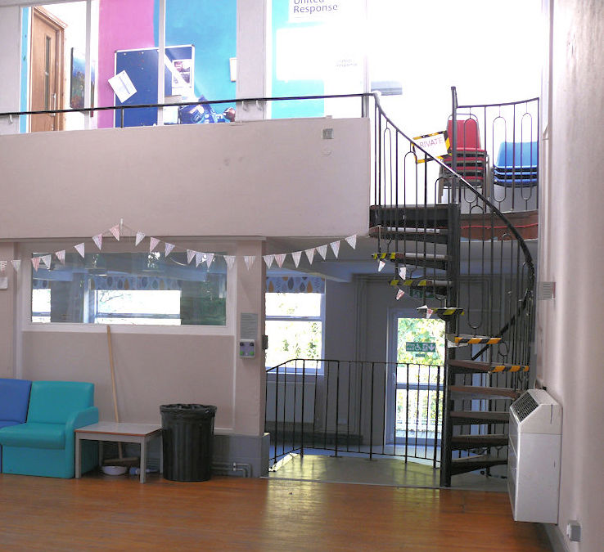
Community Fund
Organisation​ | Purpose of grant​ | Grant​
Community Use Building Honiton | Building work to enable it to install solar panels and battery storage, upgrade double glazing, and replace its gas boiler | £1,675
St Sidwell’s Community Centre | To help install an air-to-air source heat pump in this space. This will allow more people to attend cookery classes in the space, generating minimal emissions in the process. | £1,000
The Oak Room, Tiverton | To install radiant panels to run on Octopus renewable electricity supply to heat its spaces and allow people to meet | £1,800​
People’s Parkfield CIC | To purchase five electric tankless water heaters, one each for the Parkfield House kitchen and its toilets, supplying hot water to taps. This enables it to disconnect an expensive and carbon-intensive gas fired water heater currently. | £1020
2024/2025
- £5,495 given
Notes:
What is it? – a fund to spread benefit to the wider community
Aim: to provide grants for local projects that help to generate renewable energy, save energy and/or alleviate fuel poverty (tackling climate change and/or social justice)

Slide 9
Charity Transition
Continued delivery of fuel poverty and retrofit energy advice to satisfaction of partners
Intent was to transfer to Climate Action Hub and property on Queen St.
ECOE stepped back from arrangement due to issues with charity status and property
Established Sustainable Community Solutions and confirmed charity status July 2025
Remaining contracts novated to SCS at end March 2025
From April 2025 contractors delivered energy advice from SCS
ECOE retains renewable energy assets
and will continue to:
  Generate income from solar panel installations
  Pay interest to members
  Donate to our community fund
Directors approved £300,000 transfer in March 2025
No further transfers since then
Independent Financial Assessment commissioned in July 2025
Final transfer amount dependent on assessment and ECOE’s continuing viability
Provision for £480k (£300k +£180k) in Accounts

Slide 10
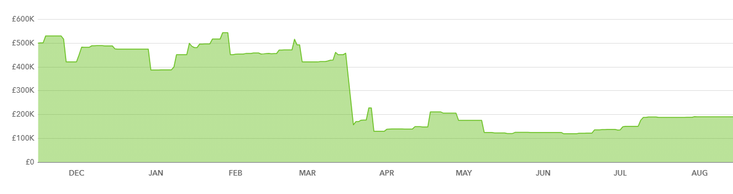
Finances for FY25
Turnover
  FY24: £997,707
  FY25: £1,003,568
Significant activities
  Exceptional transfer to SCS: £300,000 with a provision for up to £180,000 more (discussion ongoing following completion of an Independent Financial Analysis)
    This is the funding and grants for providing the Health Homes and Retrofit programmes
  Medium term loan repayments: £93,100
    This decreases our finance costs for FY26
  Higher than expected share capital repayments in year
Audit
  Subject to member agreement, the company has historically chosen to forego formal account audits*
  Proposal to invite informal audit for FY26
Cash balance
* The company is exempt from audit under section 84 of the Co-operative and Community Benefit Societies Act 2014

Slide 11
Voting
Approve Directors’ recommendation to pay shareholder interest at 5%, year ending 31st March 2025
Approve the Accounts for year ending 31st March 2025
Agree for the Accounts not to be audited
Approve Directors’ recommendation to pay £5,000 from the solar PV surplus, plus such other amounts as are decided by the Directors into the Community Fund
Approve new directors Mark Allen, Martin Shaw and Ananda Nidhi

Slide 12
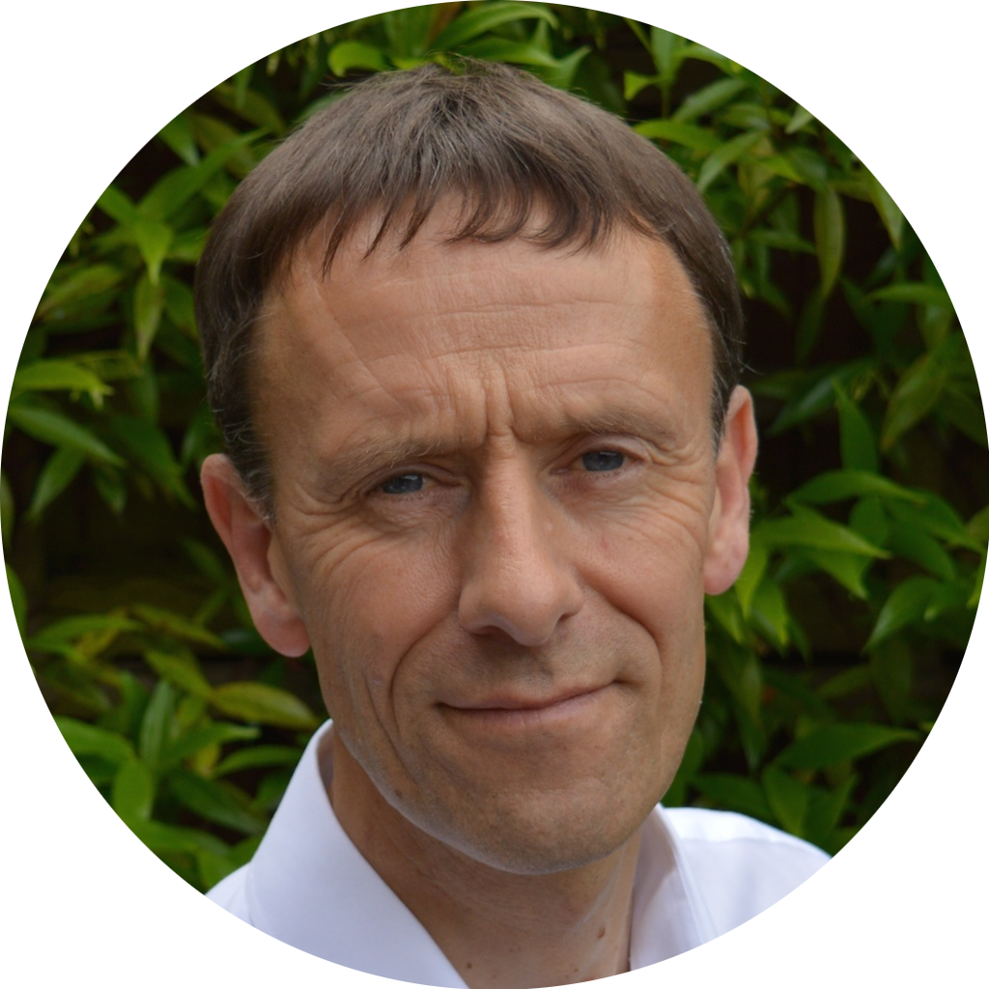
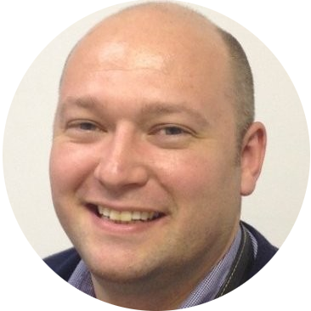

Appointments
New directors: Mark, Martin, Ananda
Mark Allen | Martin Shaw
Ananda Nidhi

Slide 13
AOB

